Slide 1
Lecture 5: Implementing Variability
Gregory Gay
TDA 594/DIT 593 - November 16, 2021

Slide 2
Variability
The ability to derive different products from a common set of assets.
Implementation: How do we build a custom product from a feature selection?
Binding Time
Technology (Language vs Tool-Based Implementation)
Representation (Annotation vs Composition)
Notes:
To implement software product lines efficiently, the underlying code has to be vari- able. Variabillity is a very general concept, so we define it specifially as the ability to derive different products from a common set of artifacts. Software design is drive by the needs of the stakeholders, manifested in features they want in a product. Instead of serving the needs of a particular stakeholder by developing a product from scratch, variable software can be tailored to stakeholder requirements. There are three dimensions we consider when looking at variability implementation techniques: Binding time, technology, and representation. We’ll introduce each, then look at some specific ways that we take these assets and produce complete, customized software

Slide 3
Today’s Goals
Basic implementation concepts
Tool-based Implementation
Preprocessors, Build Systems, Version Control
Introduce language-based implementation
Parameters

Slide 4
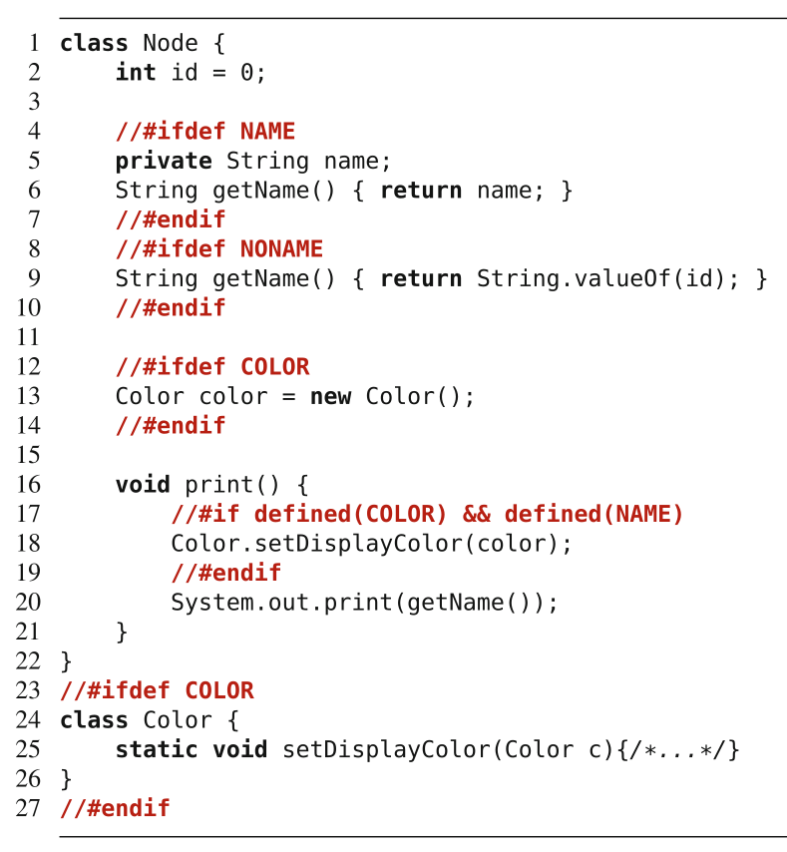
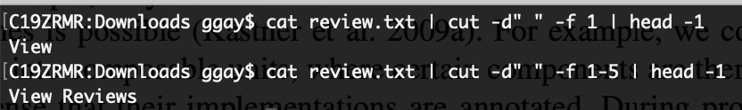
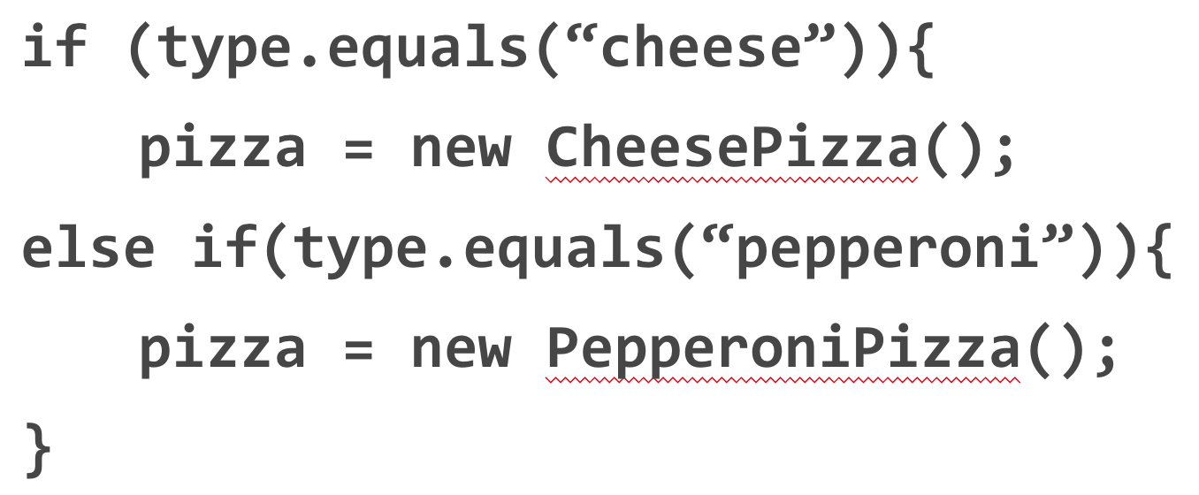
Binding Time
Compile-time Binding
Decisions made during compile.
#IFDEF preprocessor in C/C++.
Load-time Binding
Decisions made when program starts.
Configuration file or command-line flags.
Run-time Binding
Decisions made while program runs.
Method or API call.
Notes:
When we derive a product, we make decisions; we decide which features will be included in the product or not. We say that we bind a decision. Different implementation techniques allow binding decisions at different times. We can distinguish between compile-time binding (also called static binding or static variability), load-time binding, and run-time binding (also called dynamic binding or dynamic variability). With an implementation technique that supports compile-time binding, developers make decisions of which features to include at or before compile time, when we invoke the compiler. Code of deselected features is then not even compiled into the product, giving us this lean executable.We’ve seen examples a couple of times with IFDEF in C and C++, where we use preprocessors - notes left in the code - that determin what to compile. With an implementation technique that enables load-time binding, developers can defer feature selection until the program is actually started. That is, during compilation all variations are still available; they are decided after deployment, for example, through command-line parameters or configuration files. Some techniques support run-time binding, where decisions are deferred to run time and may even change during program execution ( reconfiguration triggered by external or internal input through method or API parameters). Some implementation mechanisms support mul- tiple binding times.

Slide 5
Binding Time
Compile-time binding improves performance.
… but executable cannot be reconfigured.
Load-time binding configured at execution.
Run-time binding can be configured any time.
… but reduced performance/security, increased complexity.
Notes:
The different binding times each have advantages and disadvantages. Typically, compile-time binding leaves room for more optimizations. All unnecessary code can be removed from the product, reducing run-time overhead in terms of binary footprint, memory consumption, and execution time. However, once the product has been generated and deployed, it is not variable any more—that executable cannot change, and either that customer loses the ability to customize further, or at minimum, you need to compile again. A product with load-time variability is more flexible to reconfigure. Instead of recompiling a new product after each change, end users can modify command line parameters or the configuration file and restart the same executable. A product in which variability decisions are even delayed to run time is able to react immediately, without restart, by adapting its behavior, giving ultimate flexibility. However, mechanisms for load-time and run-time binding often incur a memory and performance overhead, since all variations are compiled into a single executable and consistency conditions must be checked at run time. Including unnecessary functionality in a shipped product may also be considered as potential security threat. It can lead to undesired feature interaction, and requires much more careful testing. So, there is a trade-off to be made.

Slide 6
Technology
Language-based Implementation
Use programming language mechanisms to implement features and derive product.
Pass parameters at run-time.
Tool-based Implementation
Use external tools to derive a product.
Use preprocessor to compile only the requested features.
Notes:
Technology-wise We have two main routes we can take, classifying different product-line implementation techniques into those that are based on mechanisms provided by a programming language, called language-based approaches, and those that are based on tools that operate on software artifacts to derive products, called tool-based approaches. A language-based approach uses the mechanisms provided by a host programming language to implement features and to derive products. A tool-based approach uses one or more external tools to implement or repre- sent features in code and to control the product-derivation process. A classic language-based approach is to implement variability with run-time parameters. A classic tool-based approach is to use a preprocessor that transforms software artifacts based on a given feature selection. You cannot always draw a sharp line between language-based and tool-based approaches, but this rough distinction is enough to structure our discussion.

Slide 7
Technology
Language-Based Implementation
Feature implementation and management in code.
Easy to understand.
Feature management/boundaries easily vanishes.
Tool-Based Implementation
Separate implementation and management.
Simplifies code.
Must reason about multiple artifacts.
Notes:
In a language-based approach, both the implementation of features as well as the feature and variability management are located in the source code. This makes it easy for developers and analysis tools to understand and reason about the product line and its implementation as a whole. However, depending on the implementation approach, feature boundaries and feature management tend to vanish in the code, for example, when using run-time parameters to control feature-specific behavior. A tool-based approach favors a clear separation between feature implementation, on the one hand, and feature and variability management and product derivation, on the other. While this separation can simplify the code structure, it makes it necessary for developers and tools to locate, understand, and reason about multiple artifacts in different places

Slide 8
Annotation-Based Representation
Code in common code base.
Code related to a feature is marked.
Preprocessor annotations, if-statements.
Code belonging to deselected features:
ignored (load-time, run-time)
removed (compile-time).
Adds complexity, reduces modularity/readability.
Notes:
A major goal of product line engineering is to derive a product automatically from variable code, based on a user’s feature selection. So, product derivation involves product generation, statically or dynamically. There are two main ways to represent variability and variation points, and how products can be generated: annotation-based and composition-based approaches. In annotation-based approaches, the code of all features is merged in a single code base, and annotations mark which code belongs to which feature. In some sense, an annotation maps a program element to the feature or feature combination it belongs to. A standard example is implementing variable code using the C preprocessor, those IFDEF examples. The C or C++ code comprises the code of all products, and preprocessor directives within the C code control which code fragments are included or excluded upon a feature selection (by setting preprocessor constants). Also the use of parameters that control and alter the behavior of a program at run time can be viewed as a form of annotation too . In this case, an if statement that executes code depending on the feature selection plays the role of an annotation. During product derivation, all code that belongs to deselected features or invalid feature combinations is removed (at compile time) or ignored (at run time) to form the final product. Annotation-based approaches are widely used in practice because they are easy to use and already natively supported by many programming environments. These are what we are going to focus on mainly when we talk about implementation. However,, preprocessor-based and parameter-based implementations are also criticized for their potential complexity, lack of modularity, and reduced readability compared to proposed composition-based approaches.

Slide 9
Composition-based Representation
Feature code in dedicated location.
Class, file, package, service
Selected units combined to form product.
Requires clear mapping between features and units
Can combine annotation and composition.
Annotation-based approaches remove code.
Composition-based approaches add code.
Notes:
Composition-based approaches locate code belonging to a feature or feature com- bination in a unit of some kind - a dedicated file, pacakge, class, service, or module. During product deriva- tion, all units of all selected features and valid feature combinations are com- posed to form the final product. A classic example is a framework that can be extended with plug-ins, ideally one plug-in per feature; different products can be generated by integrating different plug-ins. The key challenge of composition-based approaches is to keep the mapping between features (problem space) and composition units (solution space) simple, ideally one-to-one. If each feature has its own imple- mentation in the form of a composition unit, a generator can simply include the corresponding unit in the composition when a feature is selected. In principle, a combination of annotation-based and composition-based approaches is possible and some blending is normal. For example, we could decompose a system into composable units, where certain components are themselves variable in the sense that their implementations are annotated. During product derivation, a generator would select a subset of composition units and remove annotated code from them that belongs to deselected features. Another way to view the difference between annotation and composition is that annotation-based approaches support negative variability (code is removed on demand), and composition-based approaches support positive variability (compo- sition units are added on demand).

Slide 10
Some Examples
Preprocessors | Compile-Time | Tool-Based | Annotation-Based
Build Systems | Compile-Time | Tool-Based | Composition-Based
Parameters | Load or Run-Time | Language-Based | Annotation-Based
Design Patterns | Load or Run-Time | Language-Based | Composition-Based
Frameworks | Load or Run-Time | Language-Based | Composition-Based
Components | Any | Any | Composition-Based
Notes:
We will discuss different approaches to implementing variability, but three core examples are preprocessor-based implementation, parameters, and design patterns. (go over)
Keep in mind, you might employ more than one of these in a given system. It is not unusual, especially, to mix parameters with design patterns or framework code.

Slide 11

Quality Criteria
We want a SPL to have:
Low preplanning effort
Feature traceability
Separation of concerns
Information hiding
Granularity
Uniformity
These often conflict!
Notes:
What implementation strategy make sense? To assess tradeoffs and compare implementation strategies, there are six quality criteria that product-line implementation techniques should ideally meet: Low preplanning effort, feature traceability, separation of concerns, information hiding, granularity, and uniformity. Not all quality criteria may be met at the same time, as some quality criteria pursue conflicting goals. Different implementation strategies focus on different criteria and make different tradeoffs.

Slide 12
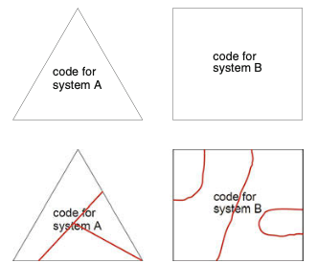
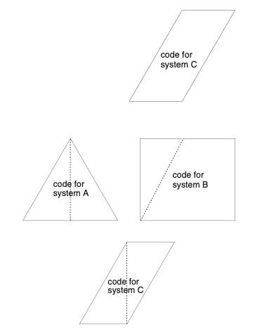
Preplanning Effort
Without Preplanning
Preplanning is required to enable code reuse.
Implementation techniques
Can minimize the need for extensive preplanning.
Can support change and addition of features.
With Preplanning
Notes:
Independent of how you implement variability, product-line engineering always requires preplanning. Which features will be requested? Which features are likely to interact? Where will one feature extend the implementation of another feature? The key goal of preplanning is to ease the anticipation of changes and sources of variability and reuse. Different implementation techniques perform differently in facilitating or hindering this task. The effort of preplanning an implementation technique requires is an important quality criterion. By studying a representative set of software products of a domain, a set of design and implementation patterns will emerge. This is a little abstract, but in the image here, we have two products, A and B, that belong to the same domain. These products bring together different code elements. Sometimes there are regular shapes, other times there are rough shapes. Now, we want to create product C. How easy is it to construct C? Can we reuse parts from other products? The answer is no. There is nothing “natural” about the “shapes“ - the structuring of the existing code elements - that would lend itself to the easy creation of C. With proper preplanning, there is a solution that allows all systems, A, B, and C, to be reconstructed from existing parts. If we structure our code properly - with clear boundaries, defined and documented interfaces - even better, with standard interfaces that are compatible between different options for the same choice - we can more easily construct a new product. The whole product-line development process involves a form of preplanning. product developers analyze an entire domain and anticipate potential requirements in terms of features. However, not all features and variations can be anticipated. Ideally, a implementation technique minimizes the pre- planning effort and allows implementing features that were not planned upfront with low effort. fostering change and minimal preplanning effort are important quality criteria for product-line implemen- tation techniques

Slide 13
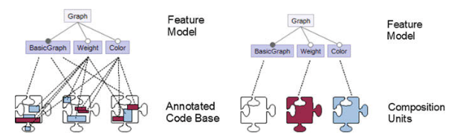
Feature Traceability
Ability to link a feature from the problem space (theoretical model) to the solution (code).
Very important to ensuring correct implementation.
Preprocessor directives are easier to detect than run-time parameters (if-statements).
Easiest to trace if feature code is contained to a single unit, harder if code is spread across units.
Notes:
Product derivation depends on establishing and managing the mapping between the problem and the solution space, in our case, between features as an idea and their corresponding implementation in the code. We can define Feature traceability is the ability to trace a feature from the problem space (for example, the feature model) to the solution space (that is, its manifestation in design and code itself). Tracing features in design and code is a key property of product-line implementation techniques. Different techniques provide different levels of support for traceability. For example, we’ve seen these preprocessor directives. These are easily recognizable by tools, but do make the code hard to read for humans. Still, they can help in pointing out what feature code belongs to. On the other hand, run-time parameters, like if-statements, are harder to trace, because they are difficult to distinguish from other variables and can be reassigned during execution. In composition-based approaches, feature traceability is trivial as long as there is one composition unit per feature. If feature code is not properly separated in terms of dedicated units (for example, one feature is implemented as part of many components of a system), feature traceability is impaired.

Slide 14
Separation of Concerns
Development should be structured into concerns (focuses) that are implemented separately.
Ignoring irrelevant details.
In a SPL, features are the concerns.
Features separated into distinct artifacts are easier to debug and maintain.
Code structures with high cohesion only contain highly related code.
Notes:
A fundamental principle in software design is to separate concerns. What we mean by a concern is an area of interest or focus in a system, and features are the main concerns of interest in developing a product line. A common approach to attain traceability is to separate features both in design and code, so that the relationship between features and corresponding design and code artifacts is explicit. When separating features into distinct artifacts, developers can easily find all code related to that feature for maintenance or evolution. Related pieces of code are implemented together, which is known as cohesion. Cohesive pieces of code are typically easier to reason about than widely scattered code fragments.Many mechanisms to separate concerns have been developed, most notably methods or functions, classes, and services. All of them facilitate some form of hierarchical or block structure.

Slide 15
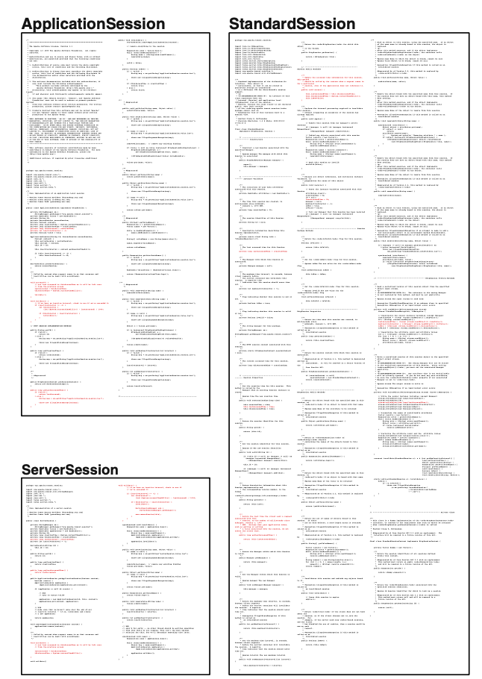
Cross-Cutting Concerns
May be difficult to separate features.
Cross-cutting concerns are features that span multiple units (classes).
Code Scattering - feature code appears across multiple other concerns.
Code Tangling - code of two features directly mixed.
Notes:
A certain class of concerns, called crosscutting concerns, is inherently difficult to separate using these block mechanisms. Using hierarchical structures like classes, a program can be decomposed in only one way (along one dimension) at a time. All concerns that do not align with the this way of structuring the system end up in scattered and tangled code across the code-base. So, a cross-cutting concern is some conceptual element, such as a feature, that results in code implemented across multiple units instead of within a single unit. This introduces two concepts we need to discuss - code scattering and tangling. Code scattering refers to a concern representation that is scattered across representations of multiple other concerns. Code tangling is a more serious form of scattering, where the code for one feature is directly intem,ingled with the code for another feature. The figure shows a snapshot of the code base of the Apache Tomcat server (in particular, the session subsystem). The code that belongs to the session-expiration feature is highlighted in red. We don’t need to be able to read the code to understand that the code for this feature is scattered across three classes, mixed with the code for other features. If we really zoom in, we can see that a lot of this is in separate blocks, so if those are separate methods, that is not too bad and we can keep track of that, but we also can see a single line here and there within other code blocks. That is potentially problematic, or at least hard to keep track of. That code is tangled directly with the code of other features, not related to session expiration.

Slide 16
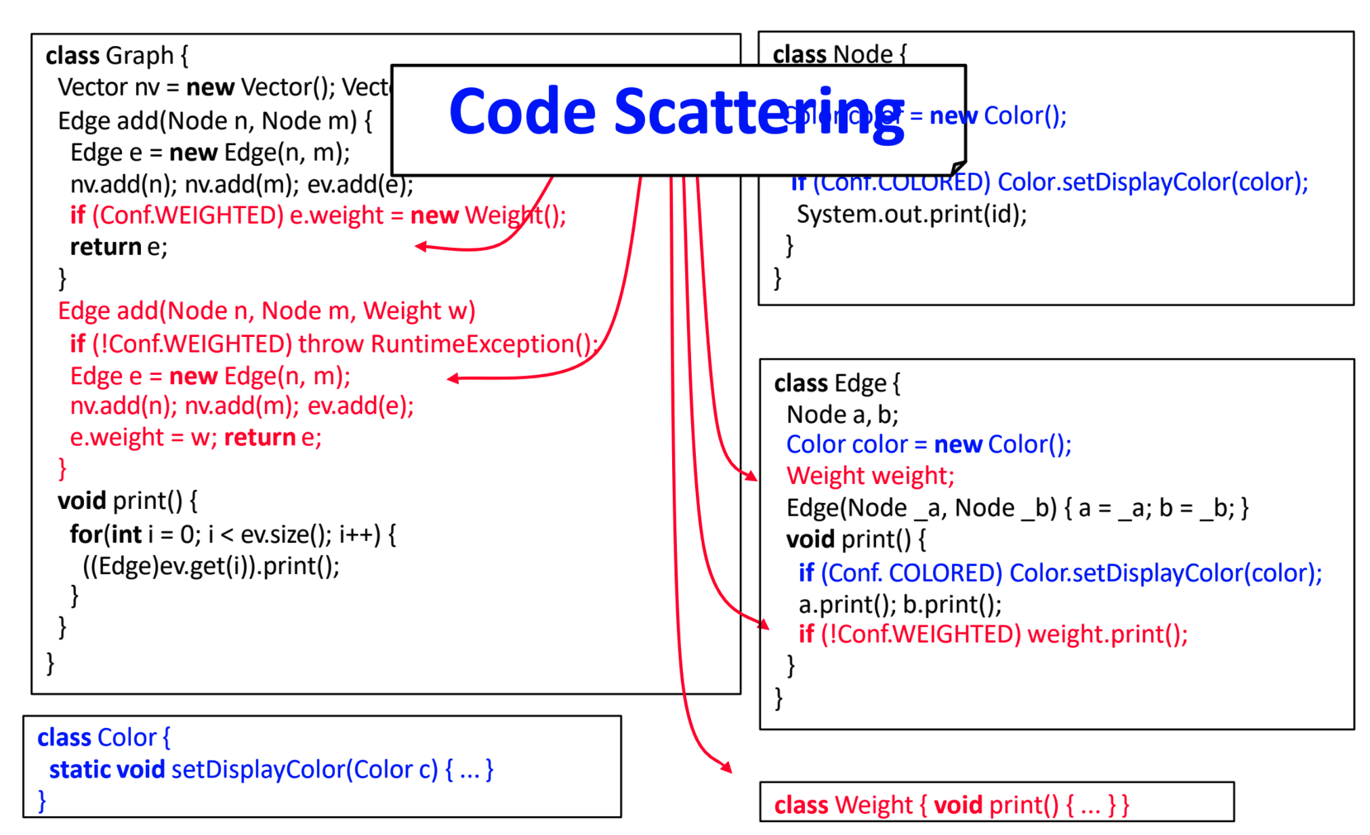
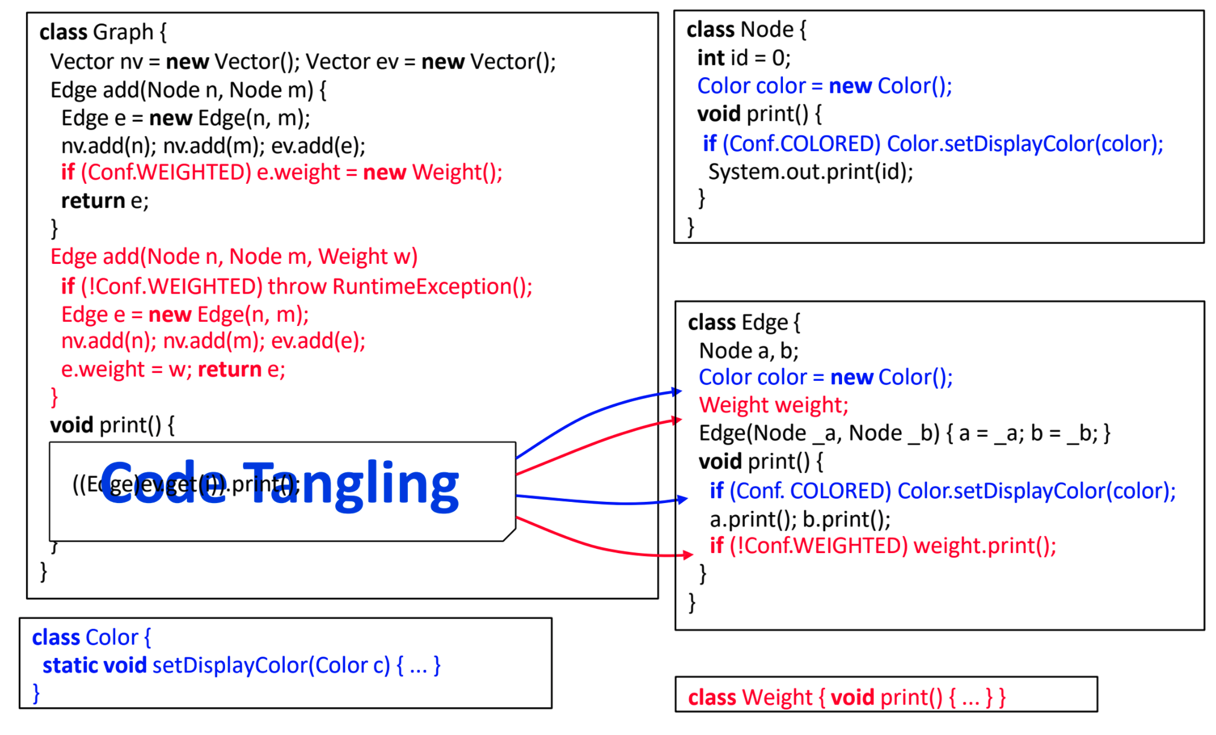
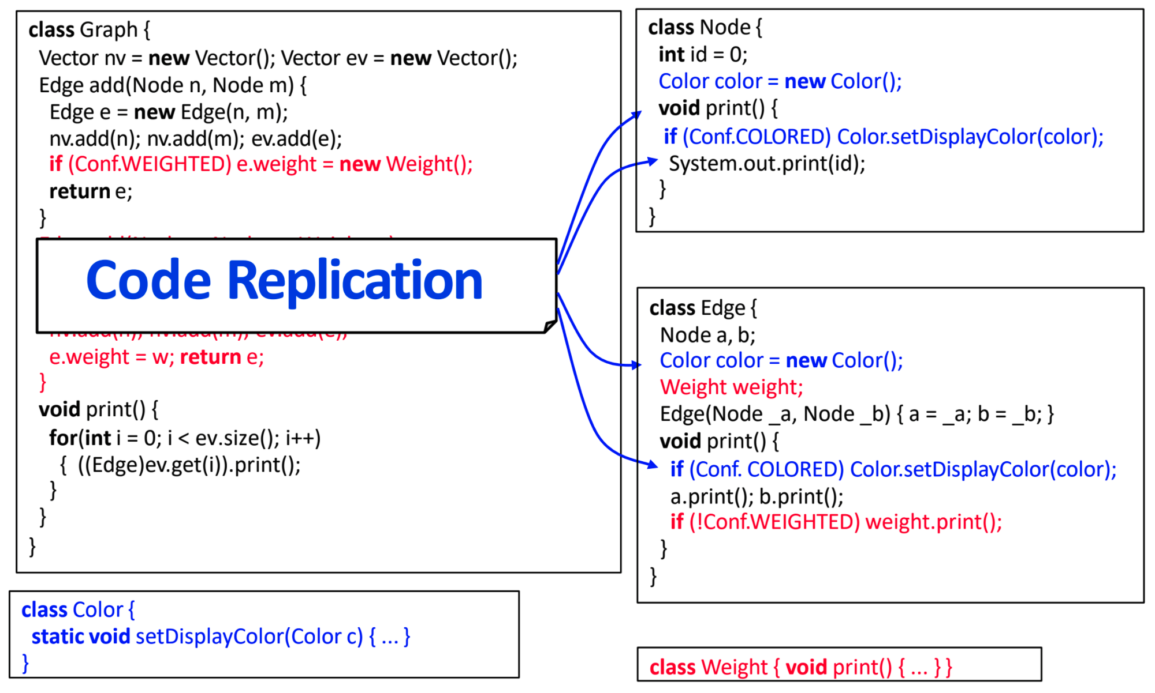
Cross-Cutting Concerns
Notes:
As another example, one we can read (go over scattering) (click) go over tangling (click) This highlights one more consequence of cross-cutting implementation, which is that we also have quite a bit of repeated code here. Because code is not modularized, we frequently see copied code - from a single line to whole methods. This is bad because, if we have to fix a bug in that code, we need to track and fix it everywhere.

Slide 17
Cross-Cutting Concerns
Scattering leads to hidden concerns.
Hard to find all feature code.
Hard to coordinate developers.
Hard to evolve code.
Some cross-cutting concerns are required.
Important to minimize number, track ones that exist.
Notes:
Scattering results in hidden concerns. hidden features, within a system. What code belongs to a feature? During maintenance, we might need to look through the whole source code. It may be hard to coordinate developers. There might be different experts for different concerns; all need to work on the same code fragment. This can lead to Low productivity, hinders evolution. When adding new functinalities, the developer needs to take care about various other concerns, which is distracting (it lowers code comprehension).
As developers, we have the freedom to choose how to decompose our system and which concerns to separate. However, we cannot separate all concerns at the same time; there will always be some concerns that do not align with the chosen structure and that will be left scattered in the codebase. In practice, this means that scattering and tangling is not necessarily a sign of bad design, but simply unavoidable. As features are often (but not necessarily) crosscutting concerns, the ability to separate even crosscutting concerns into cohesive implementations is an important quality criterion of product-line implementation technique. As much as possible, we want to be able to keep feature code self-contained, and we could try to compose our system in a way that makes this possible, which can be difficult when we generally structure a product based on its intended use. That can conflict and force feature code to be scattered instead of being self-constained at times. The important thing is to minimize scattering and tangling, and to track it when it does exist.

Slide 18
Information Hiding
Divide each module into internal and external parts:
Internal (Secret): Bulk of code
External: Interface that surfaces accessible functions
A module can be understood by examining its contents and only the interfaces of other modules.
Simplifies and un-biases development.
Allows independent teams to develop features.
Notes:
Separation of concerns decomposes a system into cohesive parts. However, separation alone might not be sufficient if, to understand the whole, developers need to understand all details of all parts. Information hiding is an important concept.The key idea of information hiding is to decompose a system into modules, and to divide each module into an internal and an external part. The internal part is also known as the module’s secret and is hidden from other modules and typically represents the bulk of the module’s code, whereas the external part describes a contract to the rest of the system and is known as an interface - it tells the rest iof the system how to communicate with this part, what services the module can provide, and what it is allowed to know about that module. Ideally, with information hiding, each module can be understood in isolation by looking just at THAT module’s secret and the interfaces of imported modules, but not the secrets of those other modules. This way, we can be sure that the behavior of this module is not influenced by secrets of the other modules. There are many different ways to specify interfaces and how to hide module internals. All share the idea that interfaces describe contracts between modules, but there are different views on how those contracts should be enforced. Interfaces can range from manually-enforced textual documentation to machine-checkable specifications of types, protocols, and so forth. Information hiding has several important consequences. By reasoning about modules separately, we can divide work and assign it to independent teams. Developers do not need to inspect the entire code base when trying to understand an individual module. Developers may also change the internal implementation of a module freely as long as they preserve the behavior specified in the interface. The interface specifies the communication between modules and all communication is made explicit in the interface. At a larger scale, we can understand the system in terms of module interfaces and compose modules by reasoning only about interfaces. Often, we can even compile and deploy modules separately.

Slide 19
Information Hiding
Key challenge is to design small, clear interfaces.
Makes communication explicit.
Enables more hiding of information.
Enables separation of concerns.
Good separation of concerns enables information hiding.
Requires both… which requires pre-planning.
Notes:
The key challenges of information hiding are to design small and clear interfaces to make communication explicit but also to maximize the secrets to hide. When separating features, we would ideally also hide the internals of their implementation and make all communication between them explicit in interfaces. This frees developers from the burden of having to know all features in a system and how they may affect each other. Different teams can be responsible for different features and work in isolation on the basis of agreed interfaces. Therefore, information hiding is a quality criterion we strive for in many product-line implementation mechanisms. Without information hiding, separating concerns into cohesive artifacts may ease code navigation and reasoning, compared to scattered and tangled code, but it cannot give guarantees; in the worst case, developers need to know the entire system, as every module could potentially influence every other. On the other hand, information hiding without an educated decision of what to hide and what to show—which is typically driven by separation of concerns and planning for change—may not separate the cohesive parts we want to reason about. For true modularity, we aspire to have both, separation of concerns and information hiding. Achieving true modularity typically requires significant preplanning though.

Slide 20
Granularity
Implementing a feature may require code changes
Coarse-grained: A new Java class
Fine-grained: Adding statements to an existing function.
Implementation mechanisms define how code can be easily changed.
Composition-based: Supports coarse-grained changes.
Annotation-based: Supports fine-grained changes.
Notes:
Features are rarely implemented in isolation from other features. A feature’s utility arises from its connections with other features in the system. Only their collaboration gives rise to desired system behavior. To interact, a feature needs to induce changes, for example, by intercepting an event or injecting statements into an existing function. Depending on the implementation technique, a feature can change a program at different levels of granularity. A level of granularity refers here to the structure of the code. Changes at the top of the hierarchical structure of an implementation artifact are coarse-grained changes. If a feature is implemented as a class or a service, that is a corse-grained element. Changes at lower levels are fine-grained. Adding a statement to a method is a fine-grained change. feature implementations take place at all levels of granularity. Encoding fine-grained extensions in product-line implementation techniques that offer only mechanisms for coarse--grained extensions can be awkward and work-intensive. So, if a feature is usually integrated into a project by importing a Java class and we want to instead implement it by injecting a new method into an existing class, that may be difficult to do. It might require code replication, where we replace entire files with locally modified variants. If fine- grained extension points are known upfront, such as the need to inject statements inside a method, developers can often also extract those fine-grained locations to more coarse-grained structures, for example, by refactoring the statements to their own method or class. The rule of thumb is that annotation-based approaches support more fine-grained integration than composition-based approaches, because the code of different features is intermixed in a common code base, and annotations can be applied at nearly every place in a code base. Composition-base approaches rely on interfaces that are defined typically at the level of classes and methods.

Slide 21
Uniformity
Features can be implemented in different languages or formats.
Product line implementation techniques should encode and process artifacts in a uniform manner.
It should not matter if code was written in C++ or Java, we should be able to work with it in the same way.
Notes:
Many of the concepts and mechanisms we discuss are independent of a particular implementation language. For example, the idea of intermixing code of different features in a single code base and using annotations to establish a mapping between features and code is applicable to Java as well as C, python, etc. the principle of uniformity states that features are implemented by a diverse selection of software artifacts and any kind of software artifact can be subject to subsequent changes and extensions. Conceptually, all artifacts (annotated or composed) should be encoded and synthesized in a similar manner.
Today’s systems, including software product lines, consist of many different kinds of software artifacts. Artifacts include code written in different languages - Android projects reghularly mix Java and C++ - as well as noncode artifacts, such as requirements, documentation, architecture descriptions, configuration files, and more. Instead of inventing approaches again and again for specific languages, which simply does not scale, it is better to have a general approach to be instantiated for all kinds of artifacts because there is only a concept to remember. It is even possible, based on such a general approach, to develop largely language-independent tools for feature implementation and product derivation. The principle of uniformity denotes an important quality criterion for product-line implementation techniques. Ideally, an implementation technique should be applicable, in principle and in practice, to a wide variety of different code and noncode artifacts, regardless of the underlying implementation technology or language.

Slide 22
Tool-Based Implementation
Notes:
External tools can also be used to implement and manage variability. In particular, we discuss preprocessors and build systems. Tool- driven approaches typically target compile-time variability, where we compile and include only code that is needed; typically, a tool decides which code fragments the compiler receives.

Slide 23
Preprocessors
Optimize code before compilation.
Often used by compilers to produce faster executable.
Can selectively include or exclude code.
Most famous - cpp
“The C Preprocessor” (C, C++)
Exist for many languages.
Notes:
A preprocessor is a tool that manipulates source code before compilation, with the intent of optimizing the final executable in some form - whether for speed or, in our case, to configure that executable for a particular use. A popular preprocessor is the C preprocessor cpp, which is used in almost every C and C++ project. Most of the examples we’ve seen of this are using cpp so far. cpp provides directives to inline files, to define macros, and to remove code frag- ments based on user-defined conditions. In addition to cpp, many other preprocessors exist, we will talk about Antenna in Java. Important in product line or variable systems development, preprocessors typically provide facilities for conditional compilation, where marked code fragments in the source code are conditionally removed before compilation— #ifdef and #endif in cpp (go over example a little). Conditional compilation is probably the most common mechanism for implementing variability in product lines in industrial practice. This is the prototypical example of tool-based, compile-time, annotation-based variability implementation.

Slide 24
Implementation with cpp
#include enables import from another file.
#include <string.h>
#define used to substitute value for reference.
Reserve one per feature.
#define FEATURE_NAME TRUE
(if the feature is selected, don’t use #define if not selected)
#ifdef/#endif used to conditionally include code.
#ifdef FEATURE_NAME
Notes:
cpp, which is mainly used for c and c++, provides facilities for file inclusion, lexical macros, and conditional compilation. Together, these enable the implementation of variability. If you have developed in c or c++, yoiu’ve seen the use of the #include directive as a way to import functionality from another source. At #include directives, the preprocessor lexically inlines files, for example, to bring in code from header files. macros are defined with #define directives. After defining a macro, the preprocessor replaces all occurrences of a corresponding token by another token sequence. Macros serve as compile-time variables and functions; they can be defined, redefined, and undefined while preprocessing a file. To implement software product lines, we reserve a name per feature (typically F as the name of the feature), and define the macro (using “#define F”) only when the feature is selected. Finally, conditional compilation, with #if, #ifdef, and similar directives can suppress token sequences so that they are not compiled. The #if directives evaluate compile-time expressions, typically checking whether macros are defined or not. So, we define a feature if we are using it, then, the ifdef check sees that that feature has a defined macro, it evaluates to true, and that code is included. For other features that we do not select, that code is ignored because we haven’t set a macro to true for that feature.

Slide 25
Implementation with cpp
#ifdef
#if defined(MACRO)
Check if a macro is defined. If true, code is included.
Define macro for included features.
#if (...) can check a user-defined condition.
Notes:
Here, we have two examples. You’ve seen the one on the left before, but to really drill it home. Three features - NAME, NONAME, COLOR. Check if these are defined using either #ifdef or #if defined. #if can also check any user-defined condition, but we generally keep this simple and just define a macro for any used feature and skip this for features not included (go over code a little)

Slide 26
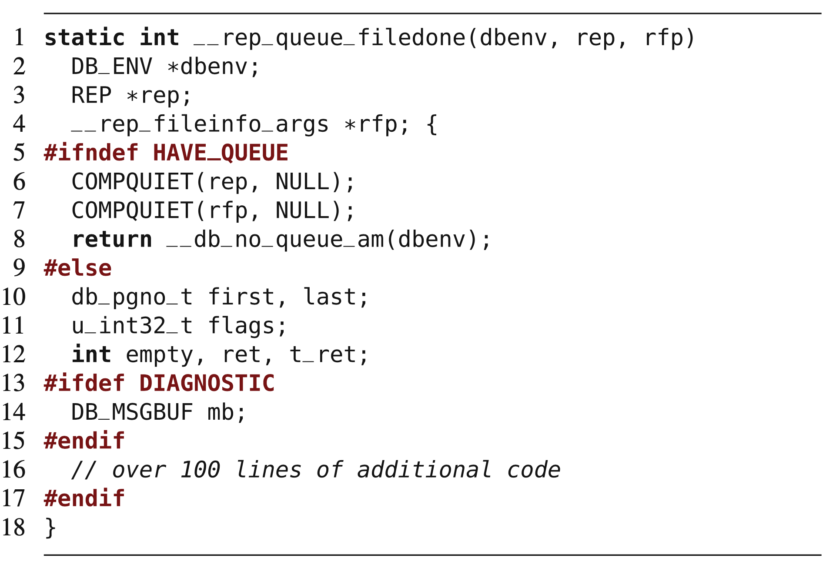
Implementation with cpp
#ifndef
“if not defined”
#else
Note nesting of directives.
Line 17 ends line 5 directive.
Notes:
Here is another example, from a database implementation. In addition to the common #ifdef and #endif directives, we can see negation (#ifndef), alternatives (#else), and nesting of preprocessor directives. The example illustrates also the common case of long annotated code fragments, here annotating over 100 lines of code (see comment in Line 16). The preprocessor removes code according to macro definitions before compilation. (go over a little)

Slide 27
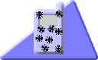
Implementation with Antenna (Java)
Similar to cpp
Annotations written as comments.
Comments out code that is not selected and uncomments code that is selected.
Available from http://antenna.sourceforge.net/
Part of FeatureIDE or can used from command line.
Notes:
cpp has been the standard way to compile C and C++ code for some time now, so this capability is innate to C or C++ development. You are unlikely to write in either language and NOT have the ability to implement variability in this manner. However, natively, Java has limited facilities for conditional compilation. So, we turn to external tools that enable this option. One of the more common is Antenna. Antenna is a preprocessor origianlly developed for Java Mobile Edition projects, which usually target embedded devices with limited resources and varying capabilities. Antenna is unusual as it integrates into existing development processes and code editors for Java. It mimics the syntax of the C preprocessor, but, preprocessor directives are written in comments not to interfere with existing code editors. Instead of removing code fragments, Antenna comments out code fragments annotated with deselected features and uncomments code fragments of selected features. This way, developers can edit Java code in their normal code editors and quickly switch between alternative feature selections; code is changed in-place and not generated in separate files. Antenna is implemented in FeatureIDE or can be used from the command line

Slide 28
Implementation with Antenna (Java)
Annotate code using comments:
//#if FEATURE_NAME
If FEATURE_NAME is chosen, include this code.
//#elif OTHER_FEATURE
else if OTHER_FEATURE chosen, include this code.
//#else
//#endif
Instead of removing lines, Antenna comments out lines, inserting //@
Notes:
Antenna uses the following directives to annotate optional code: #if expression, #elif expression, #else, and #endif (explain each). Additionally, a whole file can be annotated at once using the directive #condition expression in the first line of the file. Instead of a removal of the specific lines, Antenna uses //@ comments for the deactivation of code. Therefore, it is also possible for Antenna to use the same files as input and output to cleanly transform code.

Slide 29
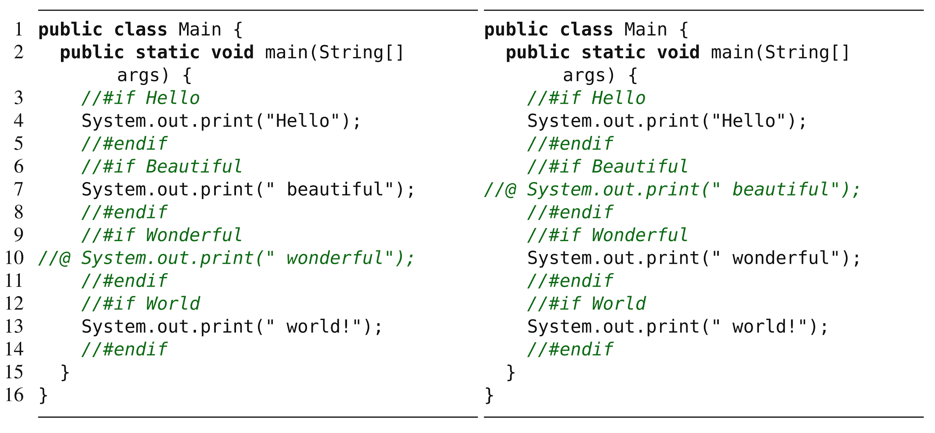
Examples
(Hello, Beautiful, World) (Hello, Wonderful, World)
Notes:
Left - we chose features Hello beautiful world, right hello wonderful world - point out annotations and commented code

Slide 30
Let’s take a break!
Notes:
Just start with a question - want you to start thinking about this. (read)
This isn’t something with one answer, or even a right answer. It’s something we’ll keep returning to

Slide 31
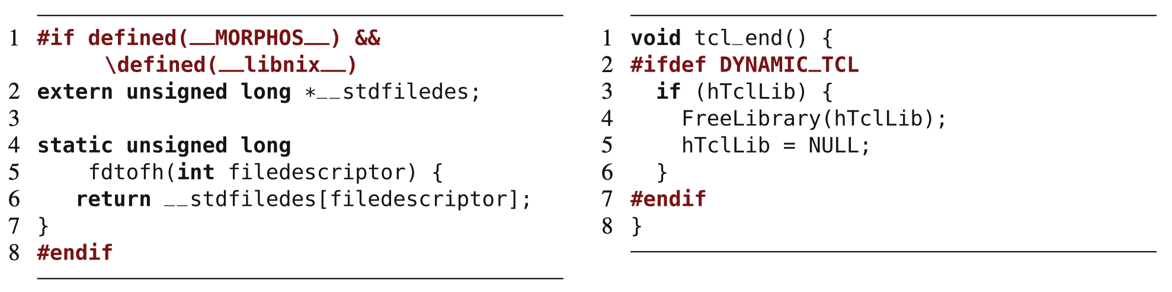
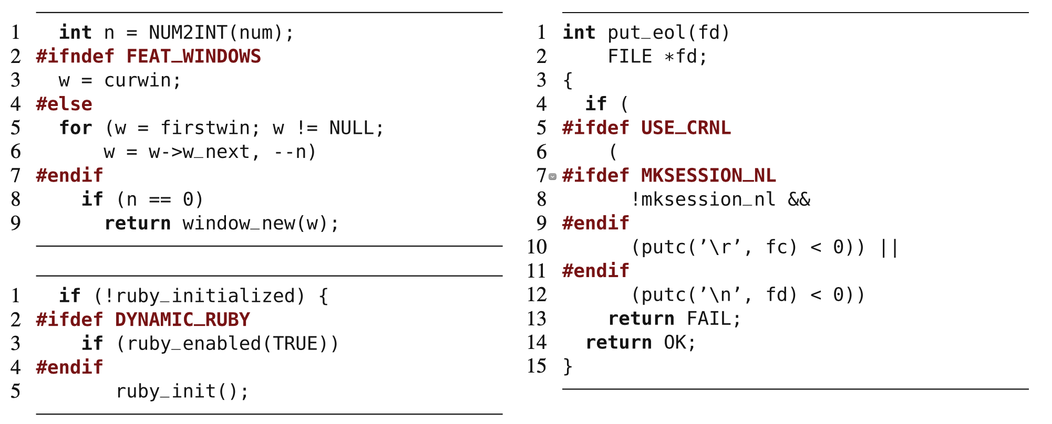
Proper Use of Preprocessors
Should wrap around an entire function, declaration, or expression.
Bad annotations wrap partial expressions.
Notes:
Preprocessors are powerful tools that allow almost arbitrary source-code manip- ulation at compile time. The power comes at the price of writing complex and hard-to-maintain and hard-to-understand source code. Similar to the goto statement, preprocessors have at times earned a poor reputation. Preprocessor annotations can align with the underlying structure but do not have to: Developers can use conditional compilation to annotate entire syntactic blocks of source, such as entire functions or entire statements, or they can wrap parts of statements or partial functions. Disciplined annotations - annotations used properly - align with the syntactic structure of the source code. Disciplined annotations can be mapped to elements of the code’s abstract syntax tree and are restricted to selected structures, typically, top-level declarations, fields, and statements, but not subexpressions or parameter declarations. On this slide, we have a number of code fragments from the source code of the text editor vim. The examples on the top are proper - they wrap around a top level declaration on the left and entire statement on the right. The ones on the bottom are not - they wrap around substatements and eubexpressions. Notice how the annotation in the first example on the bottom changes the structure and decides whether Line 8 is in the body of a for loop or not. This can result in nightmare code, where the end result is not what you exptected or wanted, and this could be a subtle failure that you miss until it causes a major issue. The notion of disciplined annotations can help developers avoid complex implementations that might be hard to maintain and are usually also easier to read and maintain.

Slide 32
Benefits of Preprocessors
Easy to learn (annotate and remove code).
Can be applied to code and other artifacts.
Allow changes at any level of granularity.
Easy to map features and code.
Can be added to a non-product line to transform it into one over time.
Notes:
On the positive side, preprocessors are lightweight and easy-to-use tools for compile- time variability that are already available in many language environments. They have a simple programming model: Annotate and conditionally remove code. Most developers, especially C developers, are familiar with them; otherwise, they are easy to learn. In environments without preprocessors, they can be added as lightweight tools, like with antenna in Java. Developers can apply lexical preprocessors such as the C preprocessor uniformly to artifacts of different kinds, even noncode and nontext artifacts. Thus, the same variability mechanism can be used for source code, grammars, models, documentation, and so forth. They allow changes at arbitrary levels of granularity, not confined by mechanisms of the host language. Fine- grained compile-time variability allows controlling precisely what code is actually deployed, even at statement level. Even disciplined annotations scale to many levels of granularity. Since most preprocessors are rather simple, it is usually easy to extract feature to code traceability information. Annotations can refer directly to features. Although feature code may not be localized in one file, a simple search or an analysis tool can statically determine the code locations affected by a feature. Finally, granularity, expressiveness, and their lightweight nature render preproces- sors well-suited for extractive product line adoption . It is easy to add a few preprocessor directives to existing code, to make code fragments optional or encode alternative. This lightweight, easy-to-learn, and easy-to-adopt nature is what makes them so popular in practice.

Slide 33
Drawbacks of Preprocessors
Feature code scattered across codebase and mixed with other features.
Encourage developers to patch and add to code instead of refactoring.
Can make it hard to understand control flow in code
Can introduce errors, especially when used on partial statements.
Notes:
Preprocessors are criticized for multiple reasons too. Feature code is scattered across the code base and tangled with code of other features. There is no support of encapsulation of features separate from other features. Even when feature code is roughly separated into distinct files, scattered annotations remain to inject the feature code into the base code. Scattering not only affects source code, but configuration knowledge as well. Configuration parameters can be defined, redefined, or undefined within the source code. Such scattering of configuration knowledge can make it hard to understand when or why a certain code fragment is included in a product. Preprocessors, due to their simplicity, invite developers to make ad hoc extensions and use “quick and dirty” solutions, instead of restructuring and refactoring the code. Features can be steadily added in a patch-by-patch fashion, but may never be removed or reflected in the design. Such ad hoc use can lead to implementations that are hard to understand and maintain. Furthermore, preprocessors are criticized for obfuscating source. Annotations are typically not part of the language, but added on top by an external tool, multiple languages are intermixed in the same file. Especially, when annotations are applied at a fine grain, are strongly scattered, or are used in undisciplined ways, it can be difficult to follow the control flow in the host language. The term “#ifdef hell” reflects this problem. The degree of source-code obfuscation depends on how the preprocessor is used. A small number of disciplined annotations is often perceived as acceptable. However, if applied in an ad hoc fashion, fine- grained annotations and a large number of annotations can quickly reduce readability. Preprocessors are also considered to be error prone. Most preprocessors lack proper diagnostic tools. Using annotations to implement optional features can easily introduce errors that can be difficult to detect. If used in an improper fashion on partial statements, even simple syntax errors, such as not closing a corresponding bracket in some feature selections can sneak in undetected. There is no way to check features in isolation, as one might attempt for modular implementations, such as plug-ins or components.
Overall, preprocessors are a simple means to implement variability, but one with several dangerous pitfalls.If used sparely in a disciplined fash- ion, and if possible with suitable tool support,, many problems can be avoided.

Slide 34
Build Systems
Schedules and executes build-related tasks.
Compilation, testing, packaging, etc.
Ex: Make, Maven, Gradle
Can be used to manage compile-time variability.
<?xml version = "1.0"?> <project name = "Hello World Project" default = "info"> <target name = "info"> <echo>Hello World - Welcome to Apache Ant!</echo> </target> </project>
Notes:
A build system is responsible for scheduling and executing all build-related tasks, which may include compiling source code, running tests, and creating and copying deliverable units. With a build system, developers document and automate the build process. Especially in large projects, a build process is not trivial, since many different build tools (compilers, linkers, testing frameworks, documentation generators) and dependencies (libraries, tools) are involved. There are many different build systems with different levels of sophistication. you’ve probably heard of or used Gradle, Maven, Ant, or even the classic Make In the simplest case, a build system is a shell script that executes the relevant tools with corresponding parameters. More sophisticated systems, such as make, ant, and maven, support multiple build targets, manage dependencies, avoid unnecessary recompilation with incremental builds, download and update required libraries and tools automatically, and create build reports. Since a build system already decides when, what, and how to compile, it is also an obvious candidate to manage compile-time variability.

Slide 35
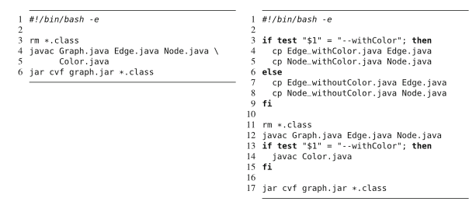
Variability in Build Scripts
Compiles code conditionally depending on features selected.
Feature selection read from file or inferred from environment (language, location, software).
Features can control how files compiled.
Notes:
Shell scripts are typical means to automate tasks. As such, they can also be used to automate builds. A simple build script in shown on the left: The script first removes all old class files, compiles all Java file, and finally packages all resulting class files in a JAR file for distribution. Now, let’s introduce variability into this build script. On the right, we check whether the parameter withColor is provided, and we compile one of two implementations of the classes Node and Edge, one with and one without colors. Further, we compile class Color conditionally. In this example, we use the parameter approach (which we will talk a little more about soon) and apply it at build-system level. Depending on the parameters, different files are compiled and packaged. Instead of passing configuration options to the build script as command-line parameters, build systems can read configuration options also from configuration files (potentially generated by a feature-selection tool). Additionally, build systems can determine configuration options automatically by inspecting the current context; for example, they can read the operating system’s language or location settings or detect whether certain hardware features or software libraries are available. When building against external libraries, variability in a build script can control which libraries (and which library revision and variant) the product is compiled with. Finally, features can control how files are compiled, including triggering optimizations, using certain compilation options, or including debugging information.

Slide 36
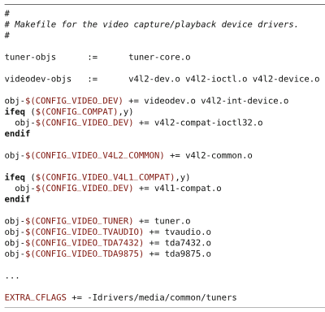
Example - Linux Kernal
Kbuild decides which files to compile based on feature selections.
obj-y += foo.o
Compile and link foo.c.
obj-m += foo.o
Build foo.c as loadable module.
lib-y += foo.o
Include foo.c as a library.
obj-(COFIG_FOO) += foo.o
(CONFIG_FOO) is a feature. Set to (y, m, n) for compile, module, skip.
Notes:
The Linux kernel is built using a custom build system, called Kbuild, which comprises a hierarchy of build scripts as input for the tool make, following a specific convention. The build scripts decide which of the several thousand C files should be compiled and linked together when building a Linux kernelfor a particular application. The logic for selecting source files for a particular configuration is spread over more than 600 smaller build scripts in the entire source tree. Some build scripts are only conditionally executed depending on the feature selection. Typical lines of a build script look like this: “obj-y += foo.o” means that file foo.c should be compiled and linked into the kernel. Similarly, the line “obj-m += foo.o” specifies that file foo.c should be built as a loadable kernel module and “lib-y += foo.o” means that the file should be included as a library. Variability is encoded in the form “obj-(CONFIG_FOO) += foo.o”, in which CONFIG_FOO is a feature name selectable in Linux’s feature model. During configuration, CONFIG_FOO is set either to y (compile), m (compile as module), or n (do not compile). This way, Kbuild controls which files are included for com- pilation for a given feature selection and how they are compiled. Of 9,146 C files in Linux release 2.6.33.3 - 97 % are included conditionally in some feature selections. Compiler parameters, such as include paths and optimization level, can be set depending on configuration options from the feature model for all files as well as for individual files. The example here shows an excerpt of the build script responsible for selecting video drivers. In the Linux kernel, the build system controls variability at the file level: It selects which files are passed to the compiler. Within file, Variability at finer granularity is expressed using preprocessor directives. So, the Linux kernel blends preprocessors AND build system-based variability management.

Slide 37
Discussion
Build systems are language agnostic (uniform).
Does not require extensive preplanning.
But no notion of consistency or modularity.
Good if features can be mapped to files.
Must replace entire file, so best if feature code mapped to single class placed in its own file.
Executes other variability mechanisms
Run pre-processors, select branch from version control, create configuration file.
Notes:
Build systems are designed to control variability at the file level. They can directly control which files to compile under which condition. Therefore, we typically consider them as an annotation-based mechanism at the file level. Usually, they support choosing from alternative variants of a file or replacing files with customer-specific variants. At the file level, a build system is language-agnostic and can uniformly implement variability for different code and noncode artifacts. As such, arbitrary changes are possible at compile time, there is no need for extensive preplanning activities, but there is also no notion of consistency or modularity. As long as features can be mapped to files, build systems are well-suited for product lines. File- level granularity can be problematic though. In case of only small changes, we may need to replicate entire files. We might have two features - two options for a variation point - that only differ by a couple of fields and a print statement ,but we still replicate most of the code over two files. If we want to fix a bug, we probably have to track and make the same changes in both locations. When multiple features affect the same file, we need mechanisms beyond file selection and file replacement. However, even with file-level variability, many implementation patterns can be used to reduce replication and enable composition. For example, developers can encode feature-specific extensions as objects in separate files and integrate them in the code using design patterns - for instance, attaching a feature’s code using a decorator or strategy object. Then, we can isolate the feature code in its own class and file. Beyond file-level variability, a build system typically is used to coordinate and execute other variability mechanisms. For example, it can conditionally apply patches, load a file from a selected branch in a version-control system, run preprocessors, or create a configuration file for configuration parameters, or plug-in loaders.

Slide 38
Parameter-Based Implementation
Notes:
Just start with a question - want you to start thinking about this. (read)
This isn’t something with one answer, or even a right answer. It’s something we’ll keep returning to

Slide 39
Language-Based Variability
Programming languages offer means to implement variability in different ways.
if-statement offers a choice between two options.
Common approaches:
Parameters
Design Patterns
Frameworks and Libraries
Components and Services
Notes:
There are many ways to implement variable code using the mechanisms of a programming language; some have been used long before the invention of software product lines. Even a simple if statement offers a choice between different execution paths. To prevent cluttering of code with if statements, to enhance feature traceability, to provide extensibility without the need to change the original source code, and to provide compile-time (or load-time) variability, developers have identified many common programming patterns to support variability, including parameters, designs patterns, frameworks, and components and services. Today, we will discuss parameters, next class we will talk about design patterns, than frameworks and components will be discussed in the class after that. These language mechanisms are well-known and commonly used in practice. Most industrial software product lines are implemented with one or more of them, working in combination to enable controlled variability. As we will see, each has benefits and downfalls

Slide 40
Parameter-based Implementation
Use conditional statements to alter control flow based on features selected.
Boolean variable based on feature, set globally or passed directly to methods:
From command line or config file (load-time binding)
From GUI or API (run-time binding)
Hard-coded in program (compile-time binding)
Notes:
We can start to talk about implementing variability in the code with the simplest method, and work our way up to more complex methods. A simple way to implement variability is to use conditional statements (such as if and switch) to alter the control flow of a program at run time based on the selections made for each variation point. In our context, conditional statements are typically controlled by configuration parameters passed to a method or a module, or set as global variables in a system. Different parameter assignments lead to different verisons - different configurations of a program when it is executed. There are many ways to set configuration parameters. In general, we expect one Boolean parameter per feature, either set globally or at an appropriate level of scoping. These variables should, ideally, be named in a way that directly maps to the feature model. Often, command-line para- meters (such as in “ssh -v”) or configuration files (such as system.ini or httpd.conf) are read at startup and stored in global variables. This is an example of load-time binding - we make choices when the program is executed, by passing in our choices from the command-line or using this configuration files. In other cases, users can change parameters in a GUI using preference dialog boxes or as part of an API request - such as a POST request to a REST api, sometimes with immediate effects - run-time binding - or at other times requiring a restart - load-time. In a third, rarer case, values of variables can also be hard-wired in source code, so changing them requires recompilation - AKA a compile-time binding. So, the use of parameters is a flexible approach, simply noting in the code how to make use of these parameter settings.

Slide 41
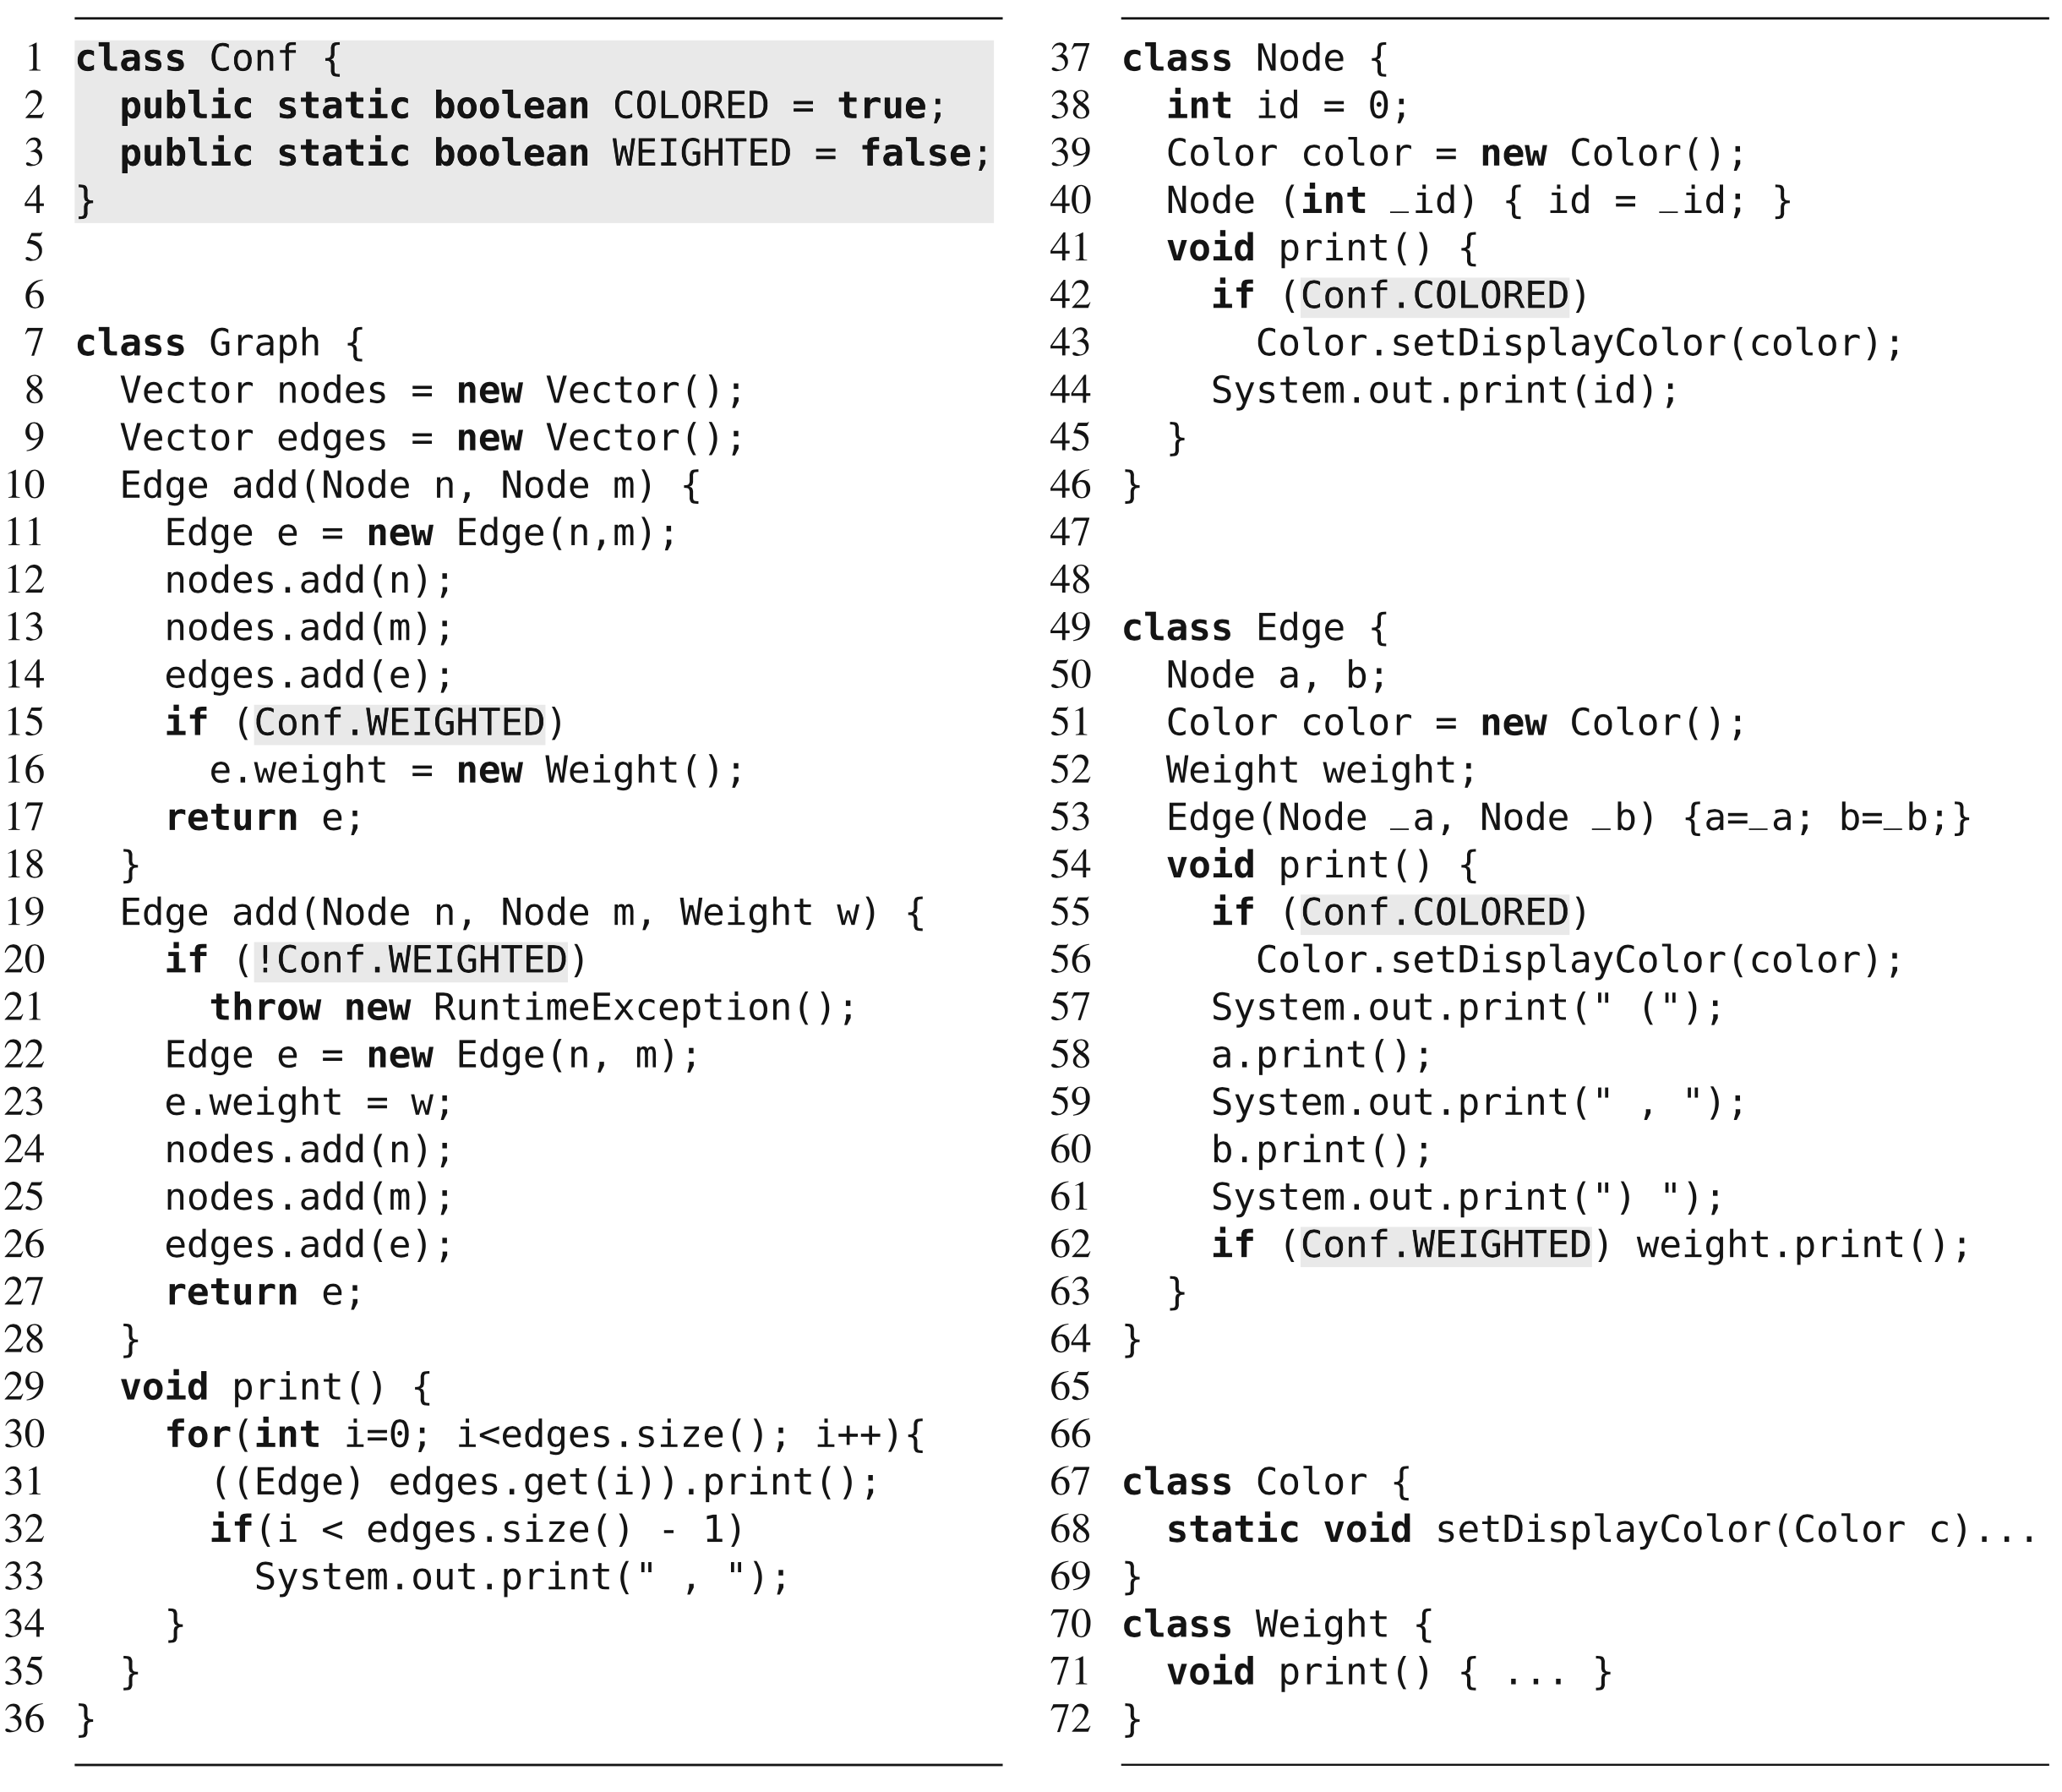
Choices read from command line and stored in Conf.
Other classes check variables and invoke code appropriately.
Notes:
This is pretty simple, and has its benefits and drawbacks. we show our graph example with two configurable features, Weighted and Colored, implemented as global configuration parameters. Class Conf stores two parameters, possibly initialized during startup from command-line parameters or from configuration files. W read in the choices from the user at load time, store the values in these parameters. These parameters are evaluated inside if statements in the classes Graph, Node, and Edge to trigger feature-specific behavior on demand.

Slide 42
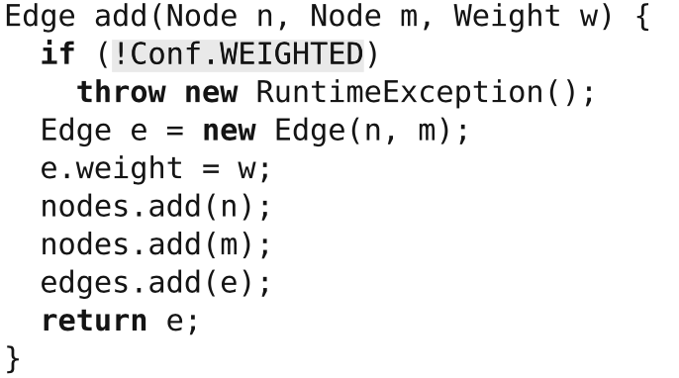
Discussion
Variation is evaluated at run-time.
All functionality is included, even if never used.
More memory required.
If-statements add computational overhead.
Security risks introduced, i.e., buffer overflow attacks.
Notes:
Implementing variability with parameters is straightforward. For this reason, it is widely used in practice. Variation is evaluated at run time when conditional statements are executed. The parameter approach shares the usual benefits and drawbacks of run-time binding. For example, all functionality is included in all deployed products, even if it is known that a feature will never be selected. This has potentially negative implications for resource consumption, performance, and security: First, deactivated function- ality is still delivered. Second, performing run-time checks requires additional computing overhead. In our example on the last slide, even though we know that we never use feature Colored, the application still contains class Color, evaluates an additional if statement whenever a method print is called, and requires memory for an additional field of every node and edge object. Third, we cannot prevent others from instantiating objects or invoking methods of deactivated feature code, other than throwing run-time errors. Finally, shipping unused code opens unnecessary potential targets for attacks, such as buffer-overflow attacks.

Slide 43
Discussion
Can alter feature selection at run-time.
However, code may depend on initialization steps.
May be easier to restart.
Can pass to methods instead of setting globally.
Allows different configurations throughout program.
Notes:
It is possible to alter a feature selection without stopping the program. However, run-time changes are nontrivial in general, as a feature’s code may depend on certain initialization steps or assume certain facts are true. For example, we might run into a null-pointer exception, if we enabled Weight at run time, because the field weight of previously created edges was uninitialized. In such cases, it might be easier to require a restart of the program, when configuration parameters change.
In addition, An advantage of passing configuration parameters as method arguments (in contrast to using global variables or using compile-time variability) is that different parts of the control flow can be configured differently. For example, we could use colored graphs and uncolored graphs in the same program.

Slide 44
Discussion
Conditional statements are a form of annotation.
Mark boundaries between features.
Global variables reduce independence of modules.
However, passing many arguments reduces understandability/requires repetition.
Pass a “configuration object” containing settings.
Feature code mixed and scattered across project.
Hard to understand and change.
Notes:
Adding conditional statements to the source code is a form of annotation - we mark our intentions, the boundaries between features, within the code. Annotations with conditional statements are available at a fine granularity. With if statements, we can change the program behavior at statement level. Configuration parameters can be encoded in essentially all programming languages; however, they are usually not applicable to noncode artifacts, such as, design documents, grammars, and documentation. Configuration parameters can lead to implementations that have a poor code quality. On the one hand, global parameters are tempting but reduce modularity (the ability to break the code into independent modules). On the other hand, propagating method arguments requires boilerplate code and may lead to methods with many parameters. A typical recommendation is to pass a single configuration object around that encapsulates multiple configuration options, known as parameter objects. Finally, with the parameter approach, variability-related code crosscuts the remaining implementation. Feature code is scattered across multiple files and modules, in variables, in method arguments, in if statements, and so forth. Furthermore, feature code is tangled with the base code and code of other features. it is difficult to encapsu- late a feature’s code behind an interface and to place all feature code in one cohesive structure. Due to the scattering and lack of cohesion, it can be nontrivial to trace a feature to all code fragments implement- ing it: one has to follow the control flow, possible assignments to other variables, and possible operations on the configuration parameters. The parameter approach can lead to undisciplined ad-hoc implementations that are difficult to analyze, maintain, and debug. It is generally preferred to use other approaches, which we will go into in the next classes.

Slide 45
Benefits and Drawbacks
Benefits
Easy to understand and use.
Flexible
Allows different configurations in same program.
Drawbacks
All code in executable.
Feature code and configuration knowledge scattered across program.
Difficult to link feature model and implementation.
Notes:
To summarize

Slide 46
We Have Learned
How do we build a custom product from a feature selection?
Binding Time
Compile, load, run-time
Technology
Language vs Tool-Based Implementation
Representation
Annotation vs Composition
Notes:
go over
annotation (mark notes in the code to denote feature boundaries), compositon (feature code is separate and plugged in from a the correct class.

Slide 47
We Have Learned
Preprocessors
Mark code to include in compiled executable.
Omit code that we do not select entirely.
Compile-Time, Tool-Based, Annotation-Based
Build Systems
Replace files based on feature selection.
Compiler options set using features.
Compile-Time, Tool-Based, Annotation-Based

Slide 48
We Have Learned
Parameters
Set Boolean variables via command-line, config file, GUI, API, etc. globally or pass to methods.
Use if-statements to execute correct code.
Load or Run-Time, Language-Based, Annotation-Based

Slide 49
Next Time
Guest lecture - Henrik Lönn, Volvo Trucks
Product lines and feature modelling in industrial development.
On Zoom - NOT in person
Will be on individual assignment, so attend!
Assignment 2 - any questions?
Due November 21
Feature modelling and analysis for mobile robots

